Slide 1


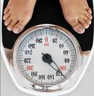

Scales and Measurement

Slide 2
Constructs and Measurement
Construct Development
  Identifying and defining what is to be measured
  A construct is a hypothetical variable composed of different elements that are thought to be related (e.g., 5 questions tapping brand loyalty)
Measurement
  Figuring out how to measure what you want to measure
  Measure needs to be reliable and valid →

Slide 3
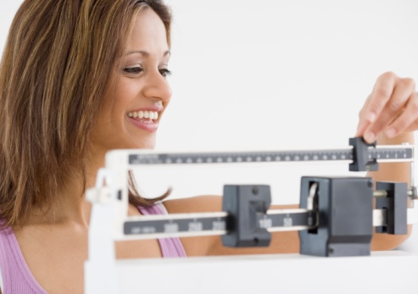
Measurement Defined
Process through which the kind or intensity of something is determined
Copyright © 2000 - 2009 by Michael J. Miller. All rights reserved.

Slide 4
Measurement means assigning numbers or other symbols to characteristics of objects according to certain prespecified rules.
  One-to-one correspondence between the numbers and the characteristics being measured.
  The rules for assigning numbers should be standardized and applied uniformly.
  Rules must not change over objects or time.

Slide 5
Scaling involves creating a continuum upon which measured objects are located.
Consider an attitude scale from 1 to 100. Each respondent is assigned a number from 1 to 100, with 1 = Extremely Unfavorable, and 100 = Extremely Favorable. Measurement is the actual assignment of a number from 1 to 100 to each respondent. Scaling is the process of placing the respondents on a continuum with respect to their attitude toward department stores.

Slide 6
Types of Data
Nominal - Assigned numbers merely represent a label
  Example: Males = 1, Females = 2; Democrat = 1, Republican = 2, Independent = 3
Ordinal - Ranking or determining an order of intensity
  Example: student ranking in a class; ranking of activities that you prefer; order in which runners finished a race
Copyright © 2000 - 2009 by Michael J. Miller. All rights reserved.

Slide 7
Types of Data (cont).
Interval - Continuum composed of equally spaced intervals but no true zero point
  Examples: IQ scores; ratings on a 5-point Likert scale (strongly disagree to strongly agree)
Ratio - Continuum that includes an absolute zero point which represents the absence of a quality
  Examples: number of customers in a store, number of questions answered correctly
Copyright © 2000 - 2009 by Michael J. Miller. All rights reserved.

Slide 8
Nominal Scale
The numbers serve only as labels or tags for identifying and classifying objects.
When used for identification, there is a strict one-to-one correspondence between the numbers and the objects.
The numbers do not reflect the amount of the characteristic possessed by the objects.
The only permissible operation on the numbers in a nominal scale is counting.
Only a limited number of statistics, all of which are based on frequency counts, are permissible, e.g., percentages, and mode.

Slide 9
Ordinal Scale
A ranking scale in which numbers are assigned to objects to indicate the relative extent to which the objects possess some characteristic.
Can determine whether an object has more or less of a characteristic than some other object, but not how much more or less.
Any series of numbers can be assigned that preserves the ordered relationships between the objects.
In addition to the counting operation allowable for nominal scale data, ordinal scales permit the use of statistics based on centiles, e.g., percentile, quartile, median.

Slide 10
Interval Scale
Numerically equal distances on the scale represent equal values in the characteristic being measured.
It permits comparison of the differences between objects.
The location of the zero point is not fixed. Both the zero point and the units of measurement are arbitrary.
Any positive linear transformation of the form y = a + bx will preserve the properties of the scale.
It is meaningful to take ratios of scale values.
Statistical techniques that may be used include all of those that can be applied to nominal and ordinal data, and in addition the arithmetic mean, standard deviation, and other statistics commonly used in marketing research.

Slide 11
Ratio Scale
Possesses all the properties of the nominal, ordinal, and interval scales.
It has an absolute zero point.
It is meaningful to compute ratios of scale values.
Only proportionate transformations of the form y = bx, where b is a positive constant, are allowed.
All statistical techniques can be applied to ratio data.

Slide 12
Characteristics of the
Types of Data
 | Level of Measurement
Characteristic | Nominal | Ordinal | Interval | Ratio
Distinctiveness | Yes | Yes | Yes | Yes
Ordering in magnitude | No | Yes | Yes | Yes
Equal intervals | No | No | Yes | Yes
Absolute zero | No | No | No | Yes

Slide 13
Characteristics of the
Types of Data (cont.)
Level of Measurement | Appropriate Calculation
Nominal | We can put the data in categories.
Ordinal | We can order the data from smallest to largest or “worst” to “best”. Each data value can be compared with another data value.
Interval | We can order the data and also compare the differences between data values. For instance, we can say that one value is 6 more than another or 10 more than another data value.
Ratio | We can order the data, calculate differences, and also find the ratio between data values. For instance, it makes sense to say that one data value is twice as large as another.

Slide 14
Measurement Error
Observed score (i.e., the value / score that is obtained)
  Observed score = True score + Measurement error
True Score – the score that would have been obtained were measurement perfect and there was no error
Measurement error – any factor that distorts the true score

Slide 15
Measurement Concepts
Operational Definition: is the definition of a variable in terms of the actual procedures used by the researcher to measure and/or manipulate it.
Similar to a ‘recipe,’ operational definitions specify exactly how to measure and/or manipulate the variables in a study.
Good operational definitions define pro-cedures precisely so that other researchers can replicate the study.

Slide 16
Measurement Error
A participant’s score on a particular measure consists of 2 components:
Observed score = True score + Measurement Error
True Score = score that the participant would have obtained if measurement was perfect—i.e., we were able to measure without error
Measurement Error = the component of the observed score that is the result of factors that distort the score from its true value

Slide 17
Factors that Influence Measurement Error
Transient states of the participants:
(transient mood, health, fatigue-level, etc.)
Stable attributes of the participants:
(individual differences in intelligence, personality, motivation, etc.)
Situational factors of the research setting:
(room temperature, lighting, crowding, etc.)

Slide 18
Actual Mistakes
Equipment malfunction
Errors in recording behaviors by observers
Confusing response formats for self-reports
Data entry errors
Measurement error undermines the reliability (repeatability) of the measures we use

Slide 19
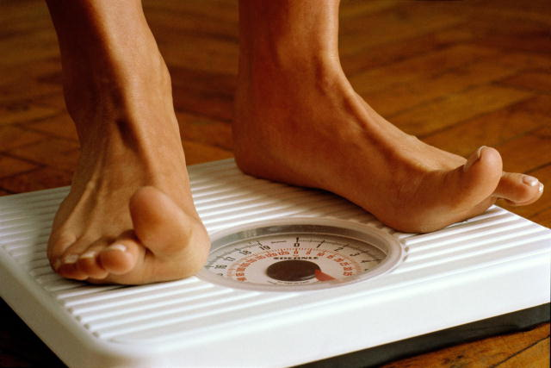
Reliability and Validity
Reliability
  consistency of measurement across time and judges
Validity
  Extent to which scores on a test or interview reflect true differences; measures what it purports to measure
Copyright © 2000 - 2009 by Michael J. Miller. All rights reserved.

Slide 20
Reliability and Validity (cont.)
Reliability does not indicate how useful the measurement is
Validity is limited by how reliable the measurement is (low reliability guarantees low validity)
If measurements are reliable, they might be valid
If measurements are not reliable, they cannot be valid
If measurements are valid, they must be reliable
Copyright © 2000 - 2009 by Michael J. Miller. All rights reserved.

Slide 21
Reliability
If a measurement has high reliability, observed scores will be very close to their true scores
Assessing reliability requires analyzing the variability in a set of scores
Total variance in Variance due Variance due
a set of scores = to true scores + measurement error
Copyright © 2000 - 2009 by Michael J. Miller. All rights reserved.

Slide 22
Reliability (cont.)
Refers to the consistency of scores (not people!)
Important to know value(s) before you conduct study
  Correlation > .70 indicates acceptable reliability
Have other sources determined the reliability and validity of the instrument?
Which approach to reliability makes the most sense?
  Stability (test-retest)
  Equivalence
  Internal consistency
Copyright © 2000 - 2009 by Michael J. Miller. All rights reserved.

Slide 23
Assessing Reliability
Reliability = True-score variance / Total variance
Usually done via correlation coefficients which express the strength of the relationship between two variables
  Values can range from -1.00 to +1.00
  Correlation of .00 indicates no relationship
  The sign indicates whether the relationship is positive or negative
Copyright © 2000 - 2009 by Michael J. Miller. All rights reserved.

Slide 24
Stability
Test-retest reliability
  Degree of temporal stability of a measuring instrument or test
  Assessed by having instrument completed by same people during two different time periods
  Problems / issues
    Familiarity with test items (practice effect)
    Attribute being measured should not change over time
Copyright © 2000 - 2009 by Michael J. Miller. All rights reserved.

Slide 25
Equivalence
Alternate (parallel) - forms reliability
  Degree of relatedness of different forms of the same test
  Fixes familiarity problem
Interrater reliability
  The consistency among two or more researchers / raters who observe and record participants’ behavior
Copyright © 2000 - 2009 by Michael J. Miller. All rights reserved.

Slide 26
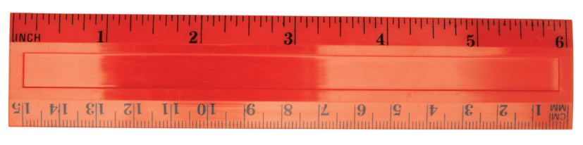
Internal Consistency
The degree of relatedness of individual items measuring the same thing (i.e., factor / dimension)
How well items “hang together”
Interitem reliability
  Assesses the degree of consistency among the items on a scale (ideally α exceeds .70)
    Item-total correlation
    Split-half reliability
    Cronbach’s alpha
Copyright © 2000 - 2009 by Michael J. Miller. All rights reserved.

Slide 27
Validity
Validity (in general)
  The extent to which conclusions drawn from a study are true
  Does an instrument measure what it purports to measure?
  “The soundness or appropriateness of a test or instrument in measuring what it is designed to measure

Slide 28
Types of Experimental Validity
Internal
  Is the experimenter measuring the effect of the independent variable on the dependent variable?
External
  Can the results be generalised to the wider population?

Slide 29
Types of Validity
Internal Validity
  When a researcher can clearly identify cause and effect relationships (i.e., there are no confounds)
External Validity
  The extent to which what you find in your study can be generalized to your target population
Construct Validity
  Extent to which your constructs of interest (e.g., sensation seeking) are accurately and completely identified (measured)
  In other words, the extent to which you are actually measuring what you say you are measuring (your sensation seeking scale really does measure the true construct of sensation seeking)

Slide 30
Types of Validity
Content Validity (Face Validity)
  Extent to which a measure is appropriate according to experts in the domain of interest
Concurrent Validity (Convergent Validity)
  Extent to which one measure of a construct overlaps with other similar measures of that construct
Discriminant Validity
  Extent to which a measure of one construct does not overlap with measures of different constructs
Predictive Validity
  Extent to which a measure of a construct can predict theoretically-relevant outcomes
Nomological Validity
  How a construct fits within a broader set of related constructs

Slide 31
Validity Criteria in Experimentation
Statistical conclusion validity
  Is there a causal relationship between X and Y?
  Correlation is our starting point (i.e. correlation isn’t causation, but does lead to it)
  Related to this is the question of whether the study was sufficiently sensitive to pick up on the correlation
Internal validity
  Has the study been conducted so as to rule out other effects which were controllable?
    Poor instruments, experimenter bias
External validity
  Will the relationship be seen in other settings?
Construct validity
  Same concerns as before
    Ex. Is reaction time an appropriate measure of learning?

Slide 32
Threats to Validity
(and possible solutions?)

Slide 33
Threats to Internal Validity
Maturation
  Changes in the DV over time irrespective of the IV

Slide 34
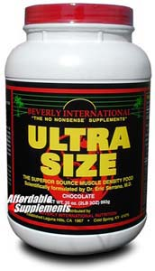
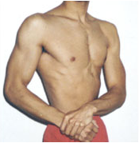
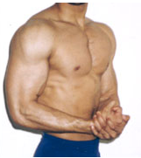
Threats to Internal Validity
Maturation
e.g. One Group Pre-test Post-test
O₁
T
O₂

Slide 35
Threats to Internal Validity
Maturation (possible solution)
Time series
O₁
O₂
O₃
T
O₄
O₅
O₆

Slide 36
Threats to Internal Validity
Maturation (possible solution)
Pre-test Post-test Randomised Group Comparison
O₁
T
O₂
n.b. RCT
R
O₃
P
O₄
PLACEBO

Slide 37
Threats to Internal Validity
Maturation (possible solution)
Repeated measures designs can occasionally be an inappropriate solution, even when randomised and counterbalanced
e.g.
Muscle Damage (repeated bout effect)
Vitamin Supplementation (wash-out period)
In which case independent measures designs could be used.

Slide 38
Threats to Internal Validity
History
  Unplanned events between measurements

Slide 39
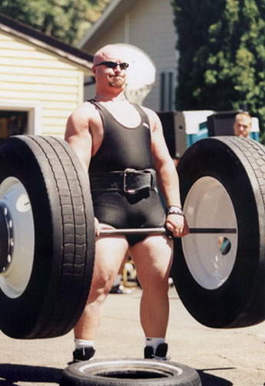
Threats to Internal Validity
History
O₁
T
O₂
e.g. exercise?
Therefore, solution = control extraneous variables!

Slide 40
Threats to Internal/External Validity
Pre-testing
  Interactive effects due to the pre-test (e.g. learning, sensitisation, etc.)
  Also influences External Validity

Slide 41
Threats to Internal/External Validity
Pre-testing
…so it is actually T+O₁ that is better than P, not T alone.
e.g.
O₁
T
O₂
Assessing muscle mass here could make them train harder in both trials…
R
…but then respond better to the T than the P…
O₃
P
O₄
PLACEBO

Slide 42

Threats to Internal/External Validity
Pre-testing (possible solution)
T
O₁
O₂
P
O₃
O₄
R
PLACEBO
T
O₅
  Solomon Four-Group Design
P
O₆
PLACEBO

Slide 43
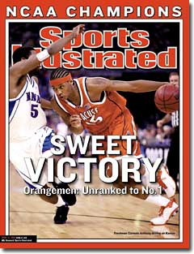
Threats to Internal Validity
Sophomore Slump & SI ‘Cover Jinx’
Statistical Regression
  AKA regression to the mean
  An initial extreme score is likely to be
  followed by less extreme subsequent scores
e.g.
Training has the greatest effect on untrained individuals.
Therefore, solution = effective sampling.

Slide 44
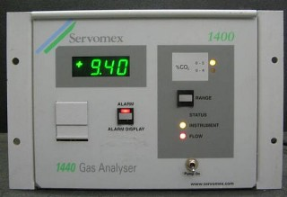
Threats to Internal Validity
Instrumentation
  A difference in the way 2 comparable variables were measured
e.g.
Uncalibrated equipment
Therefore, solution = calibrate!

Slide 45
Threats to Internal Validity
Selection Bias
  The groups for comparison are not equivalent

Slide 46
Threats to Internal Validity
Selection Bias
e.g. Groups not randomly assigned
T
O₁
i.e.
Group T were resistance trained to start with
Static Group Comparison
P
O_{a}
PLACEBO

Slide 47
Threats to Internal Validity
Selection Bias (possible solution)
T
O₁
Either:
-Randomise group assignment,
-Pre-test and post-test difference,
-Repeated Measures Design.
P
O_{a}
PLACEBO

Slide 48
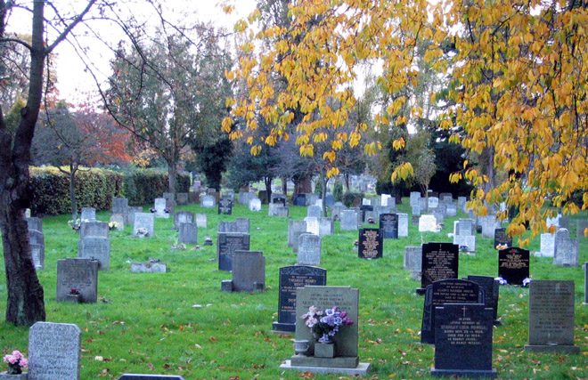
Threats to Internal/External Validity
Experimental Mortality
  Missing Data due to subject drop-out
  Reduced n = reduced statistical Power
  Not only challenges quality of data gathered (Internal Validity) but
  also our ability to
  generalise
  (External Validity).
Therefore, solution = recruit sufficient participants
(young?)

Slide 49
Threats to External Validity
Inadequate description
  5th characteristic of research…
  …should be replicable
  If nobody can replicate the methods of a given study, then it is irrefutable and therefore lacks external validity.
Therefore, solution = comprehensive methodology

Slide 50


Threats to External Validity
Biased sampling
  Linked to statistical regression
  Sample does not reflect target population
  n ≠ N
Results generalised across gender
Therefore, solution = random sample (of target population).

Slide 51
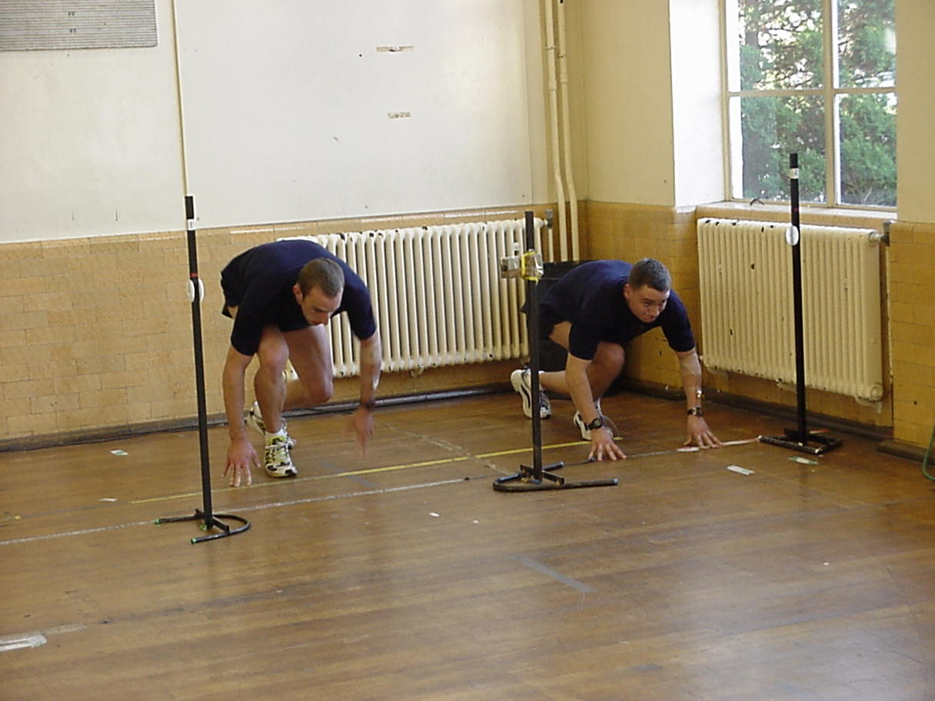
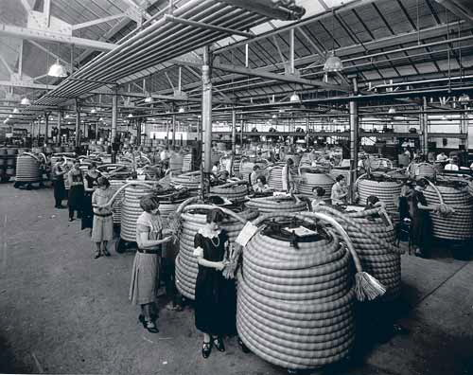
Threats to External Validity
Hawthorne Effect
  DV is influenced by the fact that it is being recorded
e.g.
Fastest sprint when professor enters lab
Therefore, solution = control the lab environment.

Slide 52

Threats to External Validity
Demand Characteristics
  Participants detect the purpose of the study and behave accordingly
  e.g.
  Sports Science students already know that the carbohydrate drink is supposedly superior
Therefore, solution = double or single blinding.
CHO
H₂O

Slide 53
Threats to External Validity
Operationalisation
  AKA Ecological Validity
  The DV must have some relevance in the ‘real world’
Therefore, solution = choose your DV carefully.

Slide 54
Key Idea
To develop reliable and valid measures which we can subsequently (and appropriately) use in statistical analyses, we must understand:
  Properties of scales
  How to design good questions that do not lead to biased or inconsistent responses

Slide 55
Measurement/Scaling Properties
Assignment
  You can assign objects to categories
Order (Magnitude)
  You can order objects in terms of having more or less of some quality
Distance (Equal Intervals)
  The distance between adjacent points on the scale is identical
Origin (Absolute Zero Point)
  Zero “means something” (absence of a given quality)

Slide 56

A Classification of Scaling Techniques
Scaling Techniques
Comparative Scales
Noncomparative
Scales
Paired Comparison
Rank Order
Constant Sum
Q-Sort and Other Procedures
Continuous Rating Scales
Itemized Rating Scales
Likert
Semantic Differential
Stapel

Slide 57
Issues in Designing
Verbal Rating Scales
Many measures taken by marketing researchers are verbal ratings
What do we need to consider when we develop verbal rating scales?
  Number of categories
  Forced vs. unforced scale
  Balanced or unbalanced scale
  Extent of verbal description
  Should response categories be numbered or not
  Comparative vs. noncomparative scale
  Scale direction

Slide 58
Number of Response Categories?
To what extent are you satisfied with your current MP3 player?
Most researchers suggest between 5 and 7 categories; for example:
1 2 3 4 5 6 7
Extremely Dissatisfied Somewhat Neither Somewhat Satisfied Extremely
Dissatisfied Dissatisfied Satisfied Satisfied
Too few does not give you enough information
Too many and it will be hard for people to discriminate between the options (e.g., a 100-point scale)

Slide 59
Forced vs. Unforced Scale?
How likely would you be to buy a car manufactured in Brazil?
Forced Scale (even number of options forces the respondent to lean one way or the other):
1 2 3 4 5 6
Very Unlikely Somewhat Somewhat Likely Very
Unlikely Unlikely Likely Likely
Unforced scale gives people a neutral option:
1 2 3 4 5 6 7
Very Unlikely Somewhat Neither Somewhat Likely Very
Unlikely Unlikely Likely Likely

Slide 60
Balanced vs. Unbalanced Scale?
How satisfied are you with your current hair stylist?
Balanced scale (same number of positive and negative options):
1 2 3 4 5 6 7
Extremely Dissatisfied Somewhat Neither Somewhat Satisfied Extremely
Dissatisfied Dissatisfied Satisfied Satisfied
Unbalanced scale (here all options are positive):
1 2 3 4 5 6 7
Somewhat Very
Satisfied Satisfied
Unbalanced scale can give biased results; unless distribution is naturally skewed to one side of the scale, should use balanced scale

Slide 61
Extent of Verbal Description?
The U.S. should invest in wind powered energy
Label endpoints or label all options?
1 2 3 4 5 6 7
Strongly Strongly
Disagree Agree
1 2 3 4 5 6 7
Strongly Moderately Slightly Neither Agree Slightly Moderately Strongly
Disagree Disagree Disagree or Disagree Agree Agree Agree
Labeling all options can aid in interpretation.

Slide 62
Should Categories be Numbered?
Toyota is an Environmentally Friendly Company
Strongly Moderately Slightly Neither Agree Slightly Moderately Strongly
Disagree Disagree Disagree or Disagree Agree Agree Agree
1 2 3 4 5 6 7
-3 -2 -1 0 1 2 3
Numbers can help respondents understand scale
1 to 7 scale quite common
But -3 to +3 can help interpretation of scale (disagree is negative, agree is positive); it may, however, overemphasize negativity
Judgment call; pretesting both scales could help identify problems
Should we have
numbers here?

Slide 63
Comparative vs. Noncomparative?
Noncomparative question
  How would you evaluate Mintifresh toothpaste?
Comparative question
  Compared to your current brand, how would you evaluate Mintifresh toothpaste?
Comparative questions establish the referent and can be useful if you need to know how your product compares to a specific competitor or the customer’s current brand
Noncomparative have the advantage of allowing the respondent to create their own referent, which can potentially improve accuracy

Slide 64
Direction of Scale?
Typical direction (lower values, negative connotation on left):
Strongly Moderately Slightly Neither Agree Slightly Moderately Strongly
Disagree Disagree Disagree or Disagree Agree Agree Agree
1 2 3 4 5 6 7
Some scales are not valenced, so must be careful about positioning. Here we see a semantic differential scale, with amusing positioning:
Unpleasant -2 -1 0 1 2 Pleasant
Flimsy -2 -1 0 1 2 Sturdy
Male -2 -1 0 1 2 Female
Hmmm…this arrangement suggests that males are to be evaluated negatively; must be careful in designing scales so as not to bias results

Slide 65
Rank-Order and
Paired Comparison Techniques
Rank-order technique
  Advantages: easy to understand, typically what we do in real-life (vs. ratings)
  Disadvantage: it may be that a person dislikes all of the options, so ranking not that informative
Paired comparisons
  Take n products, compare each one to every other (in each pair, pick the one you prefer)
  Gives you direct comparisons, but # paired comparisons can be very large as number of products to be compared increases

Slide 66
Semantic Differential Scale
Please provide your impression of Politician X:
Dumb _____ _____ _____ _____ __X__ Smart
Cold _____ _____ _____ __X__ _____ Warm
Boring _____ _____ _____ _____ __X__ Funny
Mean _____ _____ _____ __X__ _____ Nice
Please provide your impression of Politician Y:
Dumb _____ __X__ _____ _____ _____ Smart
Cold __X__ _____ _____ _____ _____ Warm
Boring _____ _____ __X__ _____ ____ Funny
Mean _____ __X__ _____ _____ _____ Nice
Profile Analysis of Politician X vs. Y:
Dumb _____ _____ _____ _____ _____ Smart
Cold _____ _____ _____ _____ _____ Warm
Boring _____ _____ _____ _____ _____ Funny
Mean _____ _____ _____ _____ _____ Nice
X
Y

Slide 67
Stapel Scale
Please provide your impression of Shoe Store X. (Use negative numbers if you feel it is inaccurate; positive numbers if you feel it is accurate):
-5 -4 -3 -2 -1 Fast Service 1 2 3 4 5
-5 -4 -3 -2 -1 Friendly 1 2 3 4 5
-5 -4 -3 -2 -1 Knowledgeable 1 2 3 4 5
Can draw comparative profile analysis (e.g., of various shoe stores) as we did with semantic differential scale (previous slide)

Slide 68
Questionnaire Design
Some Key Issues

Slide 69
Questions: Common Pitfalls
Incomprehensible
  When you consider a new stadium, is it possible that part of your determining factors might rest on the fact that you sometimes choose to forgo entertainment in favor of more pedestrian activities like walking your dog?
Unanswerable
  Will building a new stadium in Boise cost too much?
Leading
  Wouldn’t you agree that it is a great idea to build a new multiuse facility in Boise?
Double-barreled
  Do you think the old stadium needs to be replaced and a new stadium should be built downtown?

Slide 70
Purpose of Questions
Descriptive
  Describe characteristics of your sample
Predictive (Hypothesis Testing)
  What demographic factors are associated with support for the stadium?
Every question should be designed to provide useful information
  What is our primary goal in the stadium study?
  What questions are we trying to address?
How do our questions stack up?
  Good, bad questions?
  Do they each answer a question? Descriptive? Predictive?

